Slide 1
파이썬 Serial 통신 실습
경남대학교
3/17
배명진(Bae Myung Jin)

Slide 2
9일차
파이썬 Serial 통신 실습

Slide 3
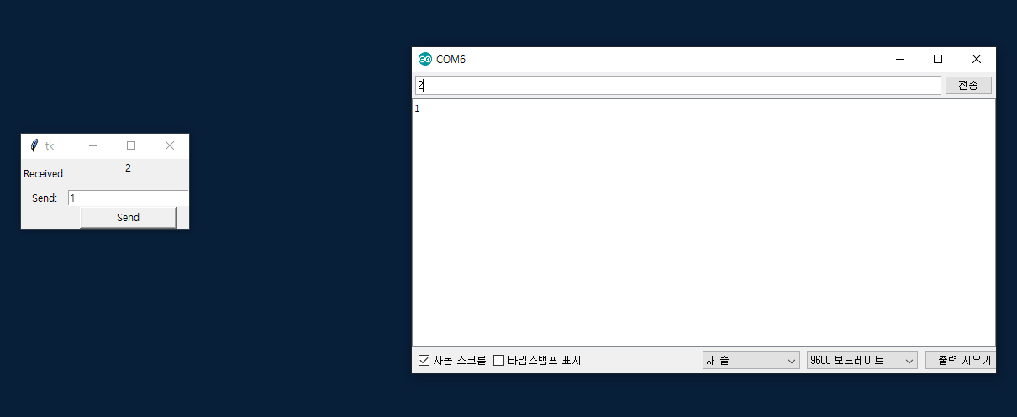
파이썬 Serial 통신 실습

Slide 4
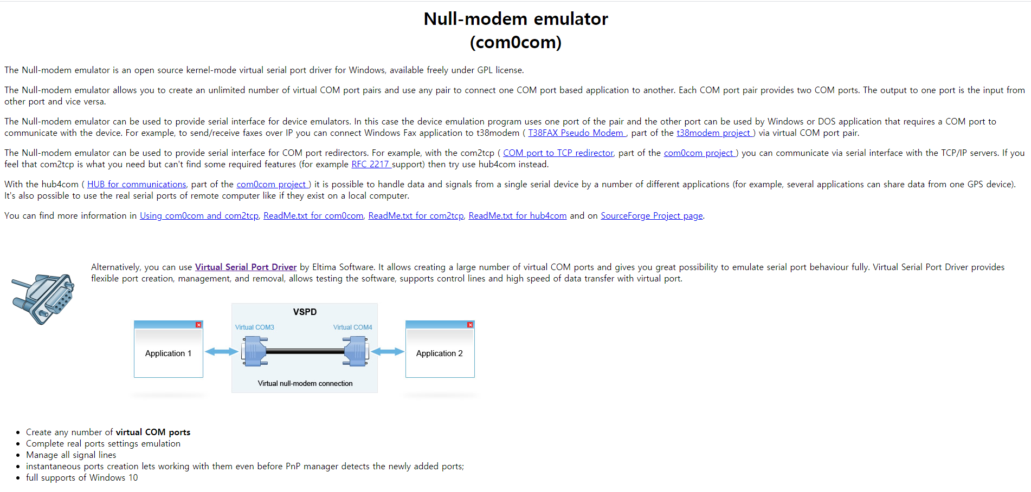
파이썬 Serial 통신 실습
http://com0com.sourceforge.net/

Slide 5
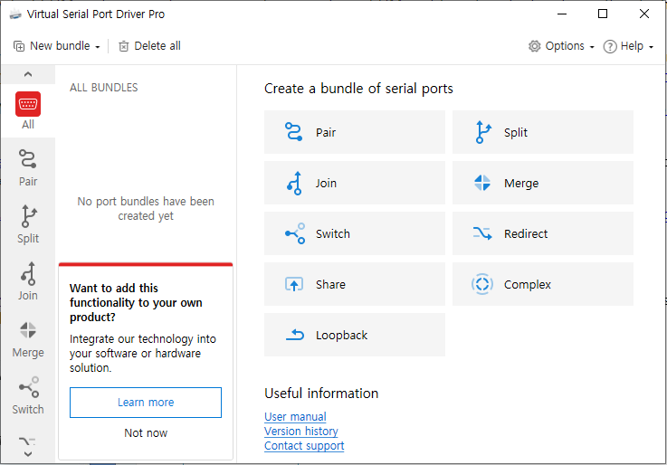
파이썬 Serial 통신 실습

Slide 6
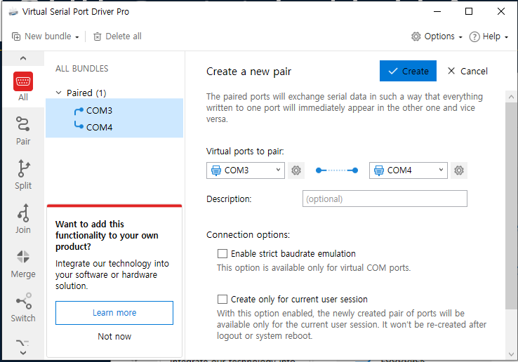
파이썬 Serial 통신 실습

Slide 7
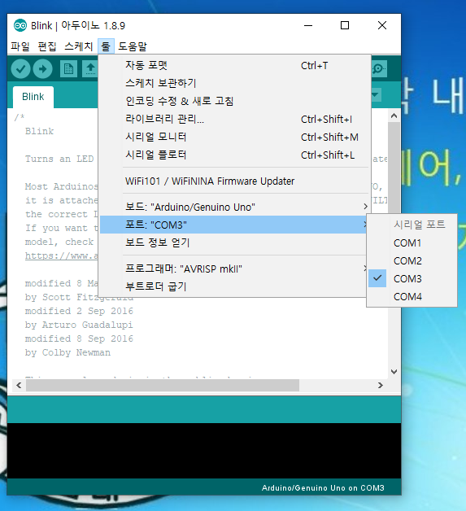
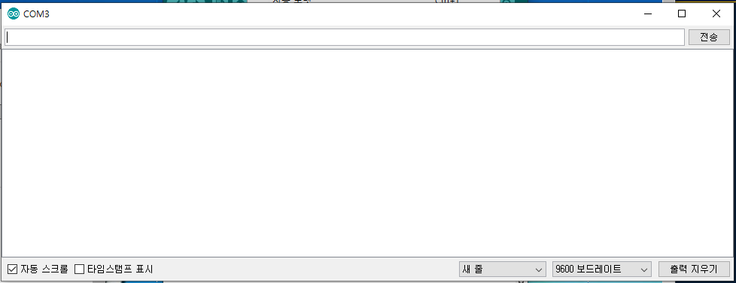
파이썬 Serial 통신 실습

Slide 8
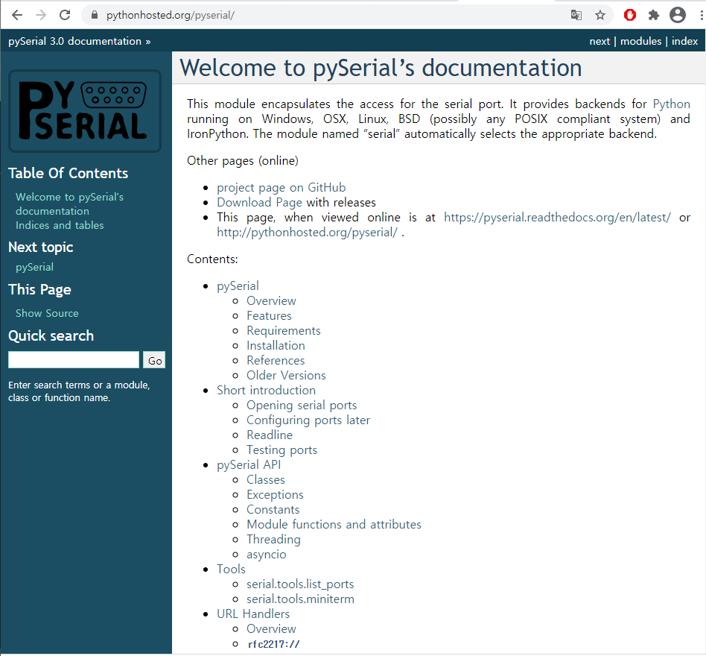

파이썬 Serial 통신 실습

Slide 9
파이썬 Serial 통신 실습
import sys
import serial
import threading
import queue
import tkinter as tk
class SerialThread(threading.Thread):
seq = serial.Serial('COM2', 9600, timeout=1)
is_run = True
def __init__(self, que):
threading.Thread.__init__(self)
self.queue = que
def run(self):
while self.is_run:
if self.seq.inWaiting():
text = self.seq.readline(self.seq.inWaiting())
self.queue.put(text)
class App(tk.Tk):
def __init__(self):
tk.Tk.__init__(self)
self.win_w = self.winfo_reqwidth()
self.win_h = self.winfo_reqheight()
self.screen_w = self.winfo_screenwidth()
self.screen_h = self.winfo_screenheight()
self.loc_x = (self.screen_w/2) - (self.win_w/2)
self.loc_y = (self.screen_h/2) - (self.win_h/2)
self.geometry('+%d+%d' % (self.loc_x, self.loc_y))
self.svar = ""
self.rlabel = tk.Label(self, text="Received:")
self.rlabel.grid(row=0, column=0)
self.rdata = tk.Label(self, text=self.svar) # Label
self.rdata.grid(row=0, column=1)

Slide 10
파이썬 Serial 통신 실습
self.slabel = tk.Label(self, text="Send:")
self.slabel.grid(row=1, column=0)
self.sdata = tk.Entry(self)
self.sdata.grid(row=1, column=1)
self.btn_send = tk.Button(self, text="Send", width=15, command=self.on_send)
self.btn_send.grid(row=2, column=1)
self.queue = queue.Queue()
self.thread = SerialThread(self.queue)
self.thread.start()
self.process_serial()
def on_send(self):
data = self.sdata.get()
SerialThread.seq.write(bytes(data, encoding='ascii'))
def process_serial(self):
while self.queue.qsize():
try:
received_data = self.queue.get()
print("Data received" + str(received_data))
self.rdata.config(text=received_data)
except queue.Empty:
pass
self.after(10, self.process_serial)
app_main = App()
app_main.mainloop()
SerialThread.is_run = False

